Slide 1
ECE 884 Deep Learning
Lecture 1: Introduction
01/19/2021

Slide 2
Self introduction
Dr. Mi Zhang, Associate Professor of Electrical and Computer Engineering
Research Areas:
AI + Mobile Computing, Internet of Things == Artificial Intelligent of Things
AI for Healthcare Applications

Slide 3
Your turn
Major?
Master or PhD Student? Which Year?
If PhD, what is your research area?
Are you familiar with linear algebra, probability, and statistics?
Do you have the basic knowledge in machine learning or pattern recognition?
Do you have a solid programming background? If so, in which language?
Do you have any experience in building systems? (e.g., mobile apps, ARMs, robots, distributed systems)
What do you want to learn from this course?

Slide 4
Class Info
Tu Th: 10:20 am to 11:40 pm
Zoom: https://msu.zoom.us/j/96813594261 (Passcode: 679307)
Course Website: Desire2Learn (D2L) website (https://d2l.msu.edu/)
Office Hours: Tu Th: 11:40 am - 12:30 pm or by appointment
Slack workspace: MSU-ECE884-2021: https://join.slack.com/t/msu-ece884-2021/shared_invite/zt-l1ug32li-ewx2T5ysbascUqgbMyRldQ
Google Sheet: https://docs.google.com/spreadsheets/d/1MQbhnmQP8OXbRV3xLxOmzwMliPqqzXu76z5P2gXIj3E/edit?usp=sharing

Slide 5
Prerequisites
Familiar with linear algebra, probability, and statistics.
Have the basic knowledge in machine learning or pattern recognition.
Solid in programming skills and python.

Slide 6

Optional Textbook
Deep Learning
An MIT Press book
Ian Goodfellow and Yoshua Bengio and Aaron Courville

Slide 7
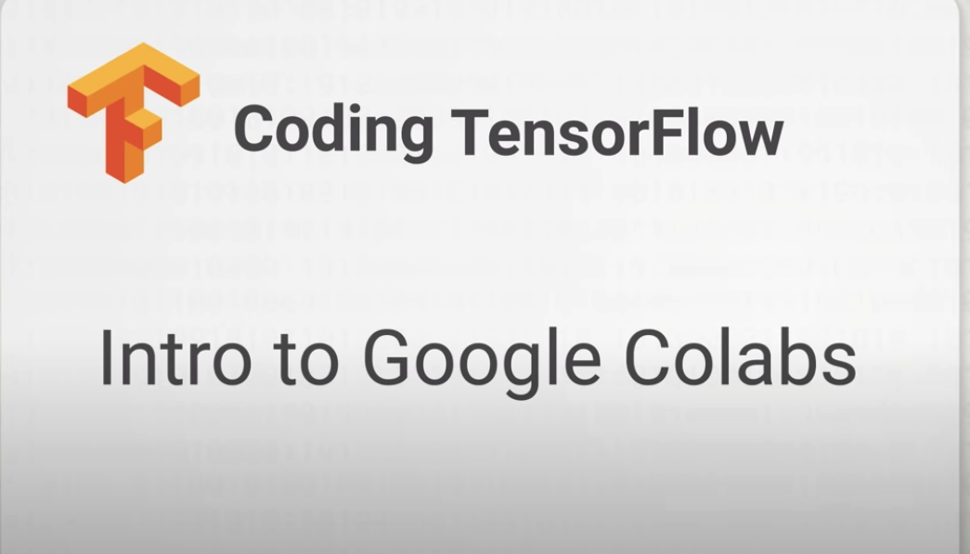
Programming Platform
Google Colab: https://colab.research.google.com/notebooks/intro.ipynb

Slide 8

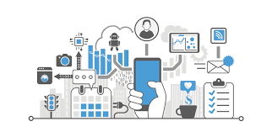

What this course is about
Deep Neural Networks
Deep Learning Systems and Applications

Slide 9
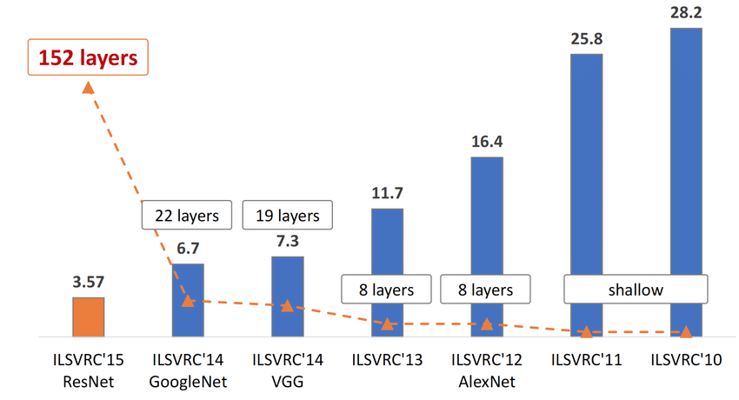
Section 1: Basics of Deep Neural Networks

Slide 10
Section 1: Basics of Deep Neural Networks
Convolutional Neural Networks

Slide 11
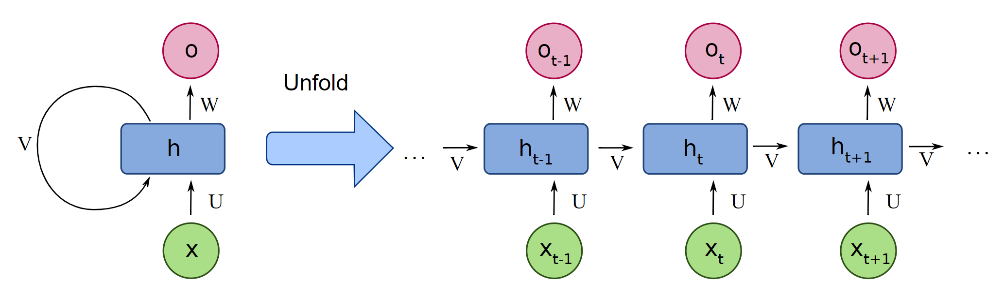
Section 1: Basics of Deep Neural Networks
Recurrent Neural Networks

Slide 12
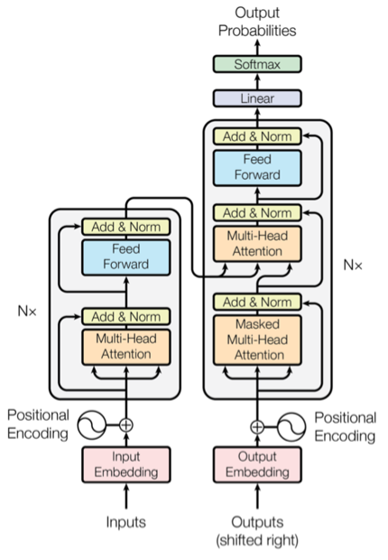
Section 1: Basics of Deep Neural Networks
Transformers

Slide 13
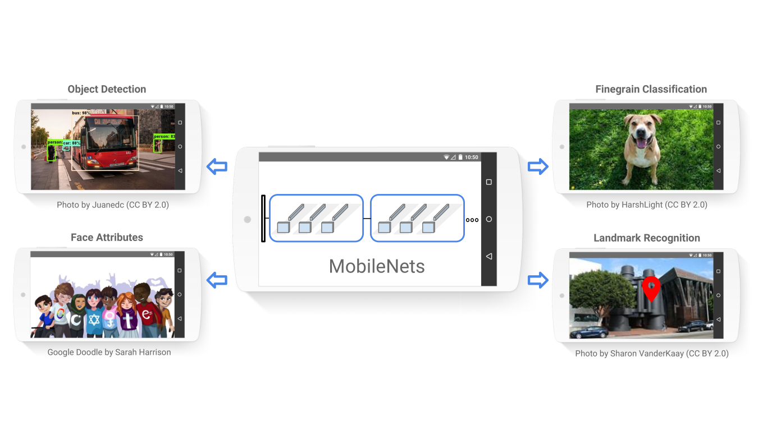
Section 1: Basics of Deep Neural Networks
MobileNet

Slide 14
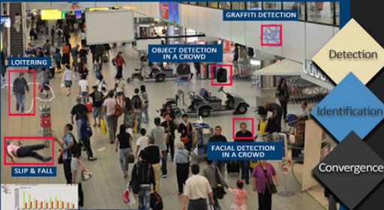
Section 2: Deep Learning Systems and Applications
Video Analytics Systems

Slide 15
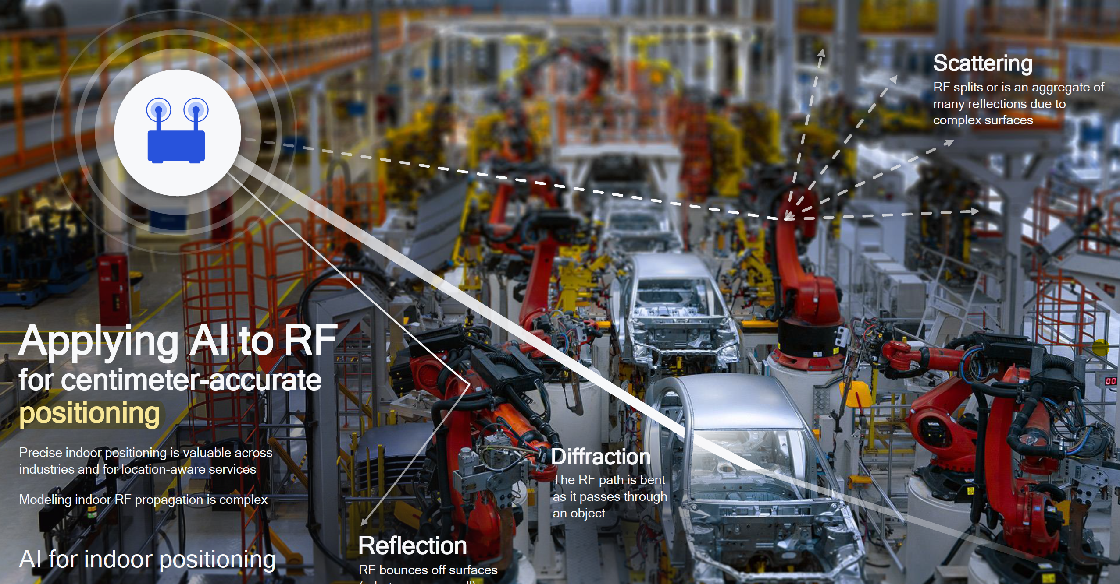
Section 2: Deep Learning Systems and Applications
Wireless Systems

Slide 16
Assignments
Paper reading reports and presentations (40%) - Individual
Paper reports
Paper presentations and discussions
Semester long project (60%) - Group
Select one application area / topic
Propose an idea on what you want to do
Final presentation and demo

Slide 17
What this course will NOT teach you
Not teaching you linear algebra, probability, and statistics.
Not teaching you how to program with Python.
Not teaching you how to debug (We do NOT have a TA).
You have to learn how to use Google Colab / TensorFlow, how to code in Python, how to debug your code by yourselves.

